Slide 1
Intro to Angular 2
Spencer Schneidenbach

Slide 2
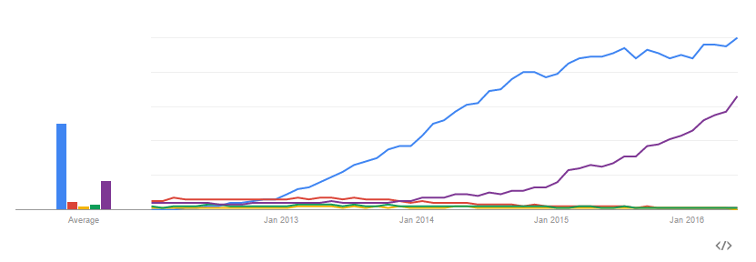

History lesson
Angular 1 – started in 2009
Hugely popular – won the initial “SPA war”

Slide 3
Angular 2
Announced in 2014
Shook the boat quite a bit
Lots of big changes
Lots of initial pushback

Slide 4
Angular 1 to 2 - What’s changed?
Controllers to components
No more $scope! Yay!
Digest loop to unidirectional data flow
Two-way data binding to… unidirectional data flow
Native event/property binding
Way fewer custom directives
Binding directly to DOM properties/events
Simplified service model
Easier to understand. Flatter learning curve.

Slide 5
Angular 1 to 2 – What stayed the same?
Template syntax is very similar
One-way data binding via interpolation {{ }}
Still use directives in the same way
Dependency injection is still used
Directives and components

Slide 6
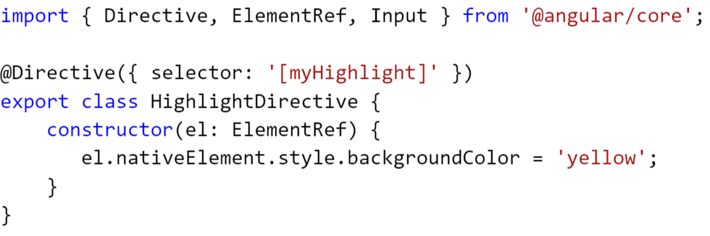
Directives
Used to modify behavior of DOM elements
There are also structural directives and attribute directives
Here is an attribute directive (from angular.io)
Structural directives can add/remove DOM elements

Slide 7
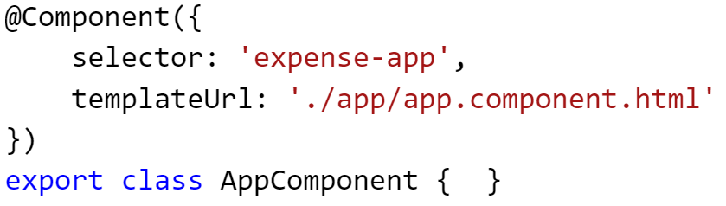
Components
Components are directives with a template
Angular 2 apps are built with components
In TypeScript, they’re just classes with the Component decorator
No more $scope, no more controller

Slide 8
Components, cont’d
Component scope is much easier to understand
No more transclusion, isolate scope, etc.
Functions/properties are bound directly from component
Encapsulated
Example: styling applied directly to component isn’t exposed out

Slide 9
Declaring a component
Create your class
Import the Component decorator
Add a template and a selector

Slide 10
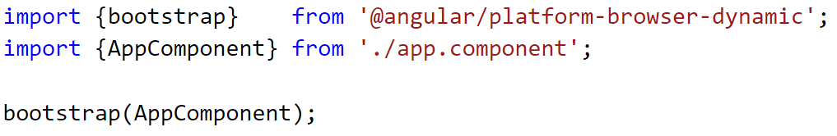
Running your app
Choose your base component – this is your app host
Add it to your index.html page
Bootstrap it!

Slide 11
Steps to setting up your app
Write your component
Write your “main” method
Write your container (index.html)
Import the proper scripts
Choose your module loader
Run your app!

Slide 12
Demo!

